Slide 1


FLORIDA
DEPARTMENT
of STATE
2020 Conduct of Elections
Analysis
Supervisor of Elections Training Series
April 22, 2021

Slide 2
2020 Conduct of Elections Analysis
102.141(10)(a), F.S.
At the same time that the official results of an election are certified to the Department of State, the county canvassing board shall file a report with the Division of Elections on the conduct of the election. The report must describe:
1. All equipment or software malfunctions at the precinct level, at a counting location, or within computer and telecommunications networks supporting a county location, and the steps that were taken to address the malfunctions;
2. All election definition errors that were discovered after the logic and accuracy test, and the steps that were taken to address the errors;
3. All ballot printing errors or ballot supply problems, and the steps that were taken to address the errors or problems;
4. All staffing shortages or procedural violations by employees or precinct workers which were addressed by the supervisor of elections or the county canvassing board during the conduct of the election, and the steps that were taken to correct such issues;
5. All instances where needs for staffing or equipment were insufficient to meet the needs of the voters; and
6. Any additional information regarding material issues or problems associated with the conduct of the election.

Slide 3
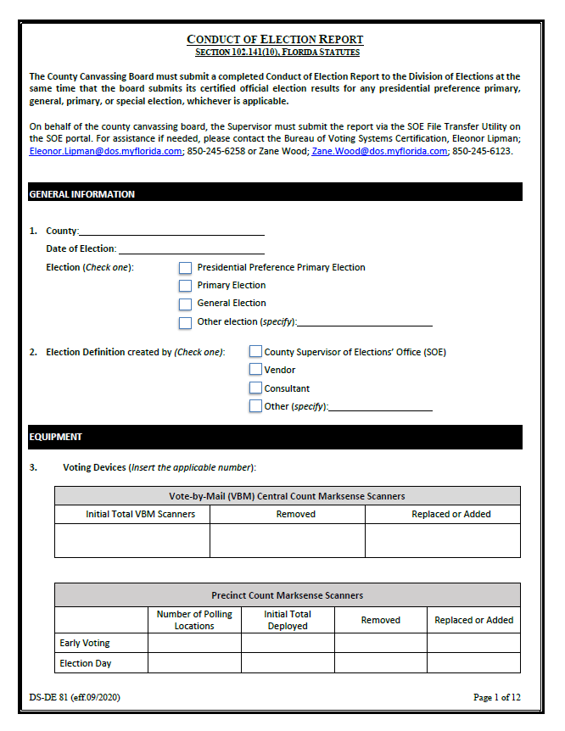

Slide 4
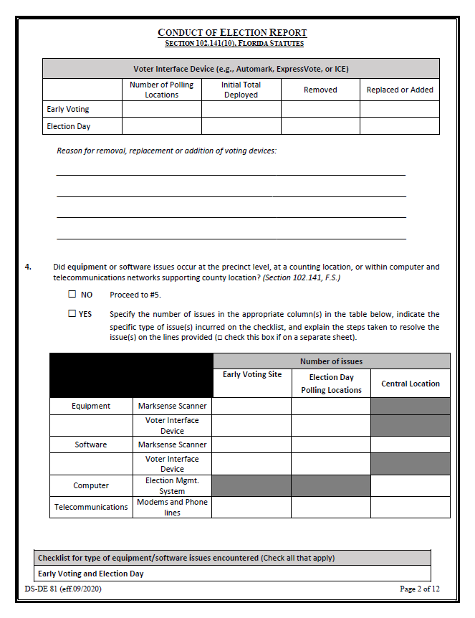

Slide 5
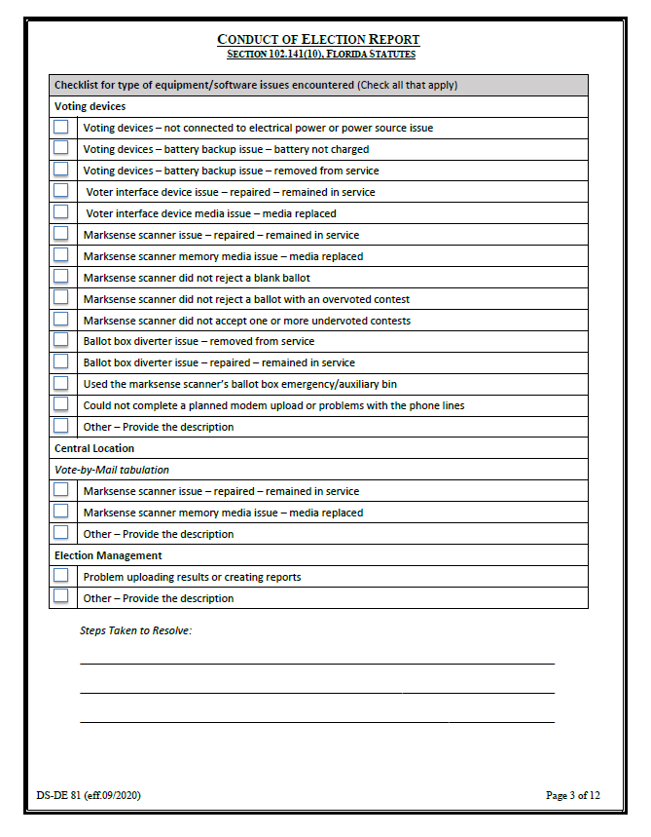

Slide 6
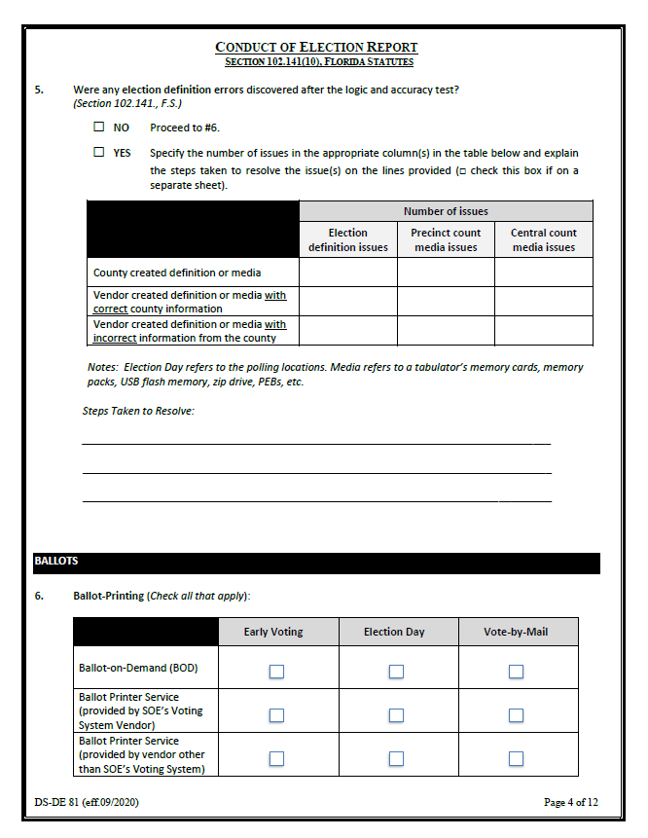

Slide 7
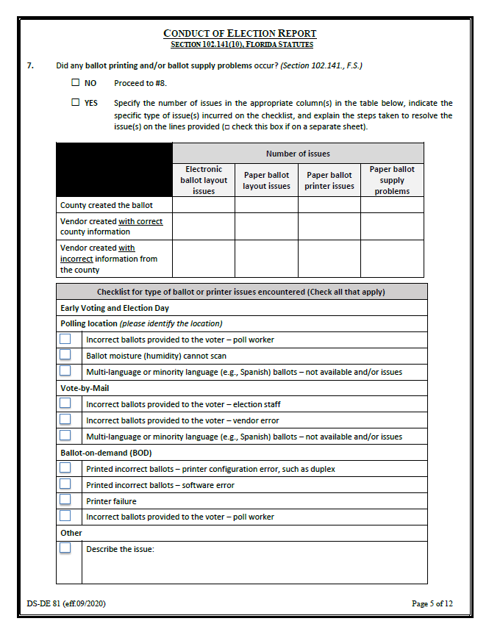

Slide 8
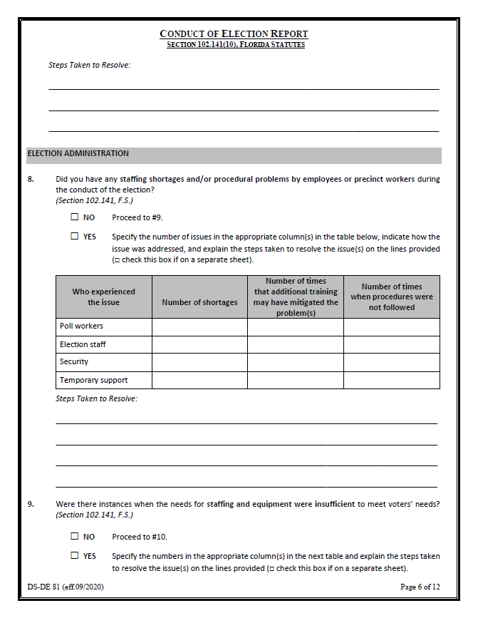

Slide 9
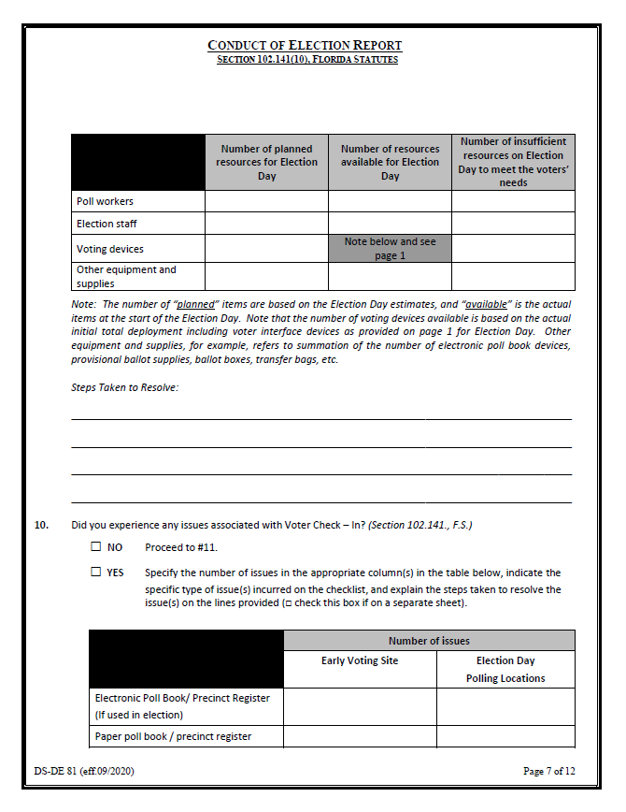

Slide 10
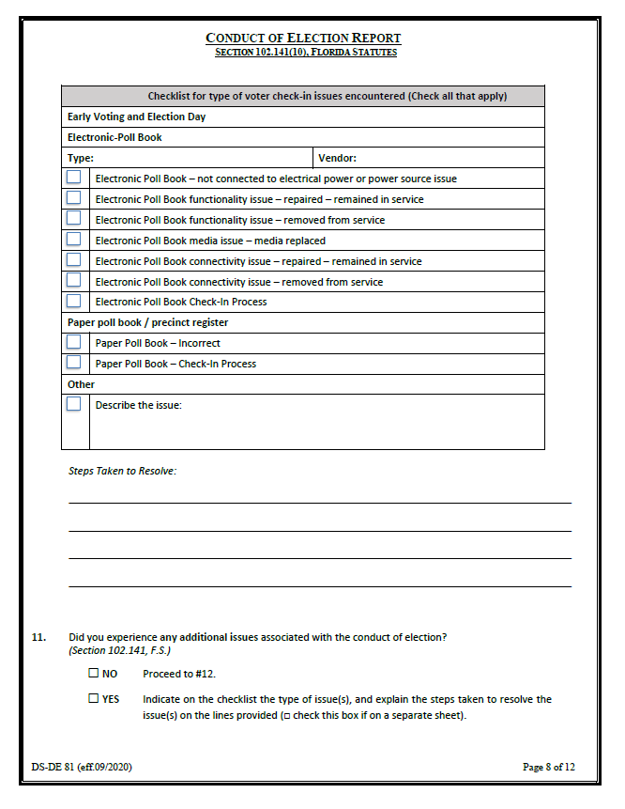

Slide 11
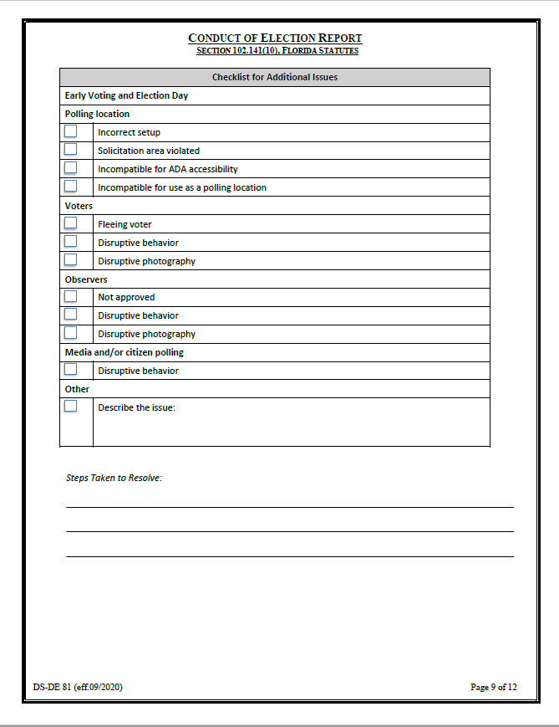

Slide 12
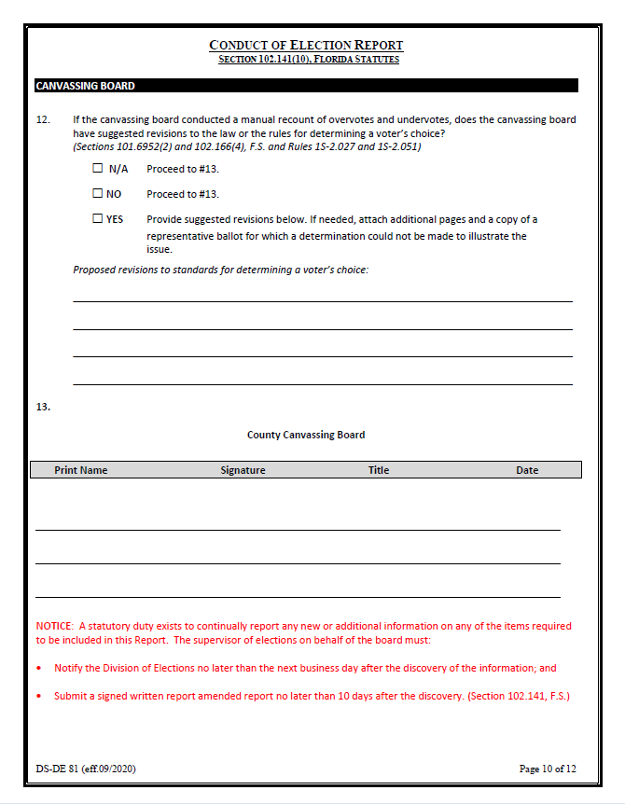

Slide 13
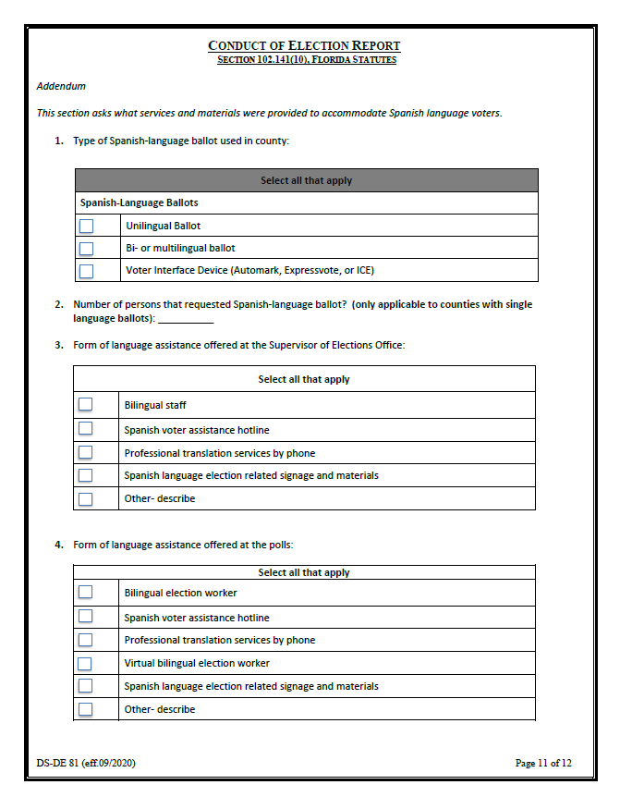

Slide 14
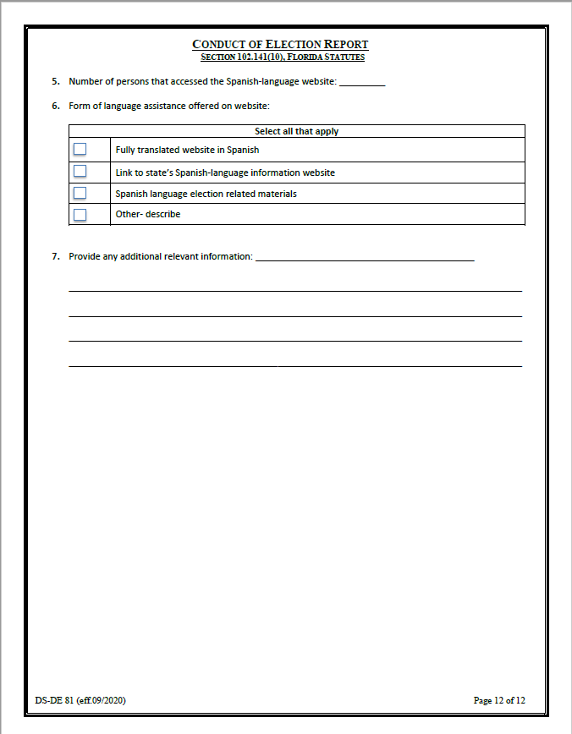

Slide 15
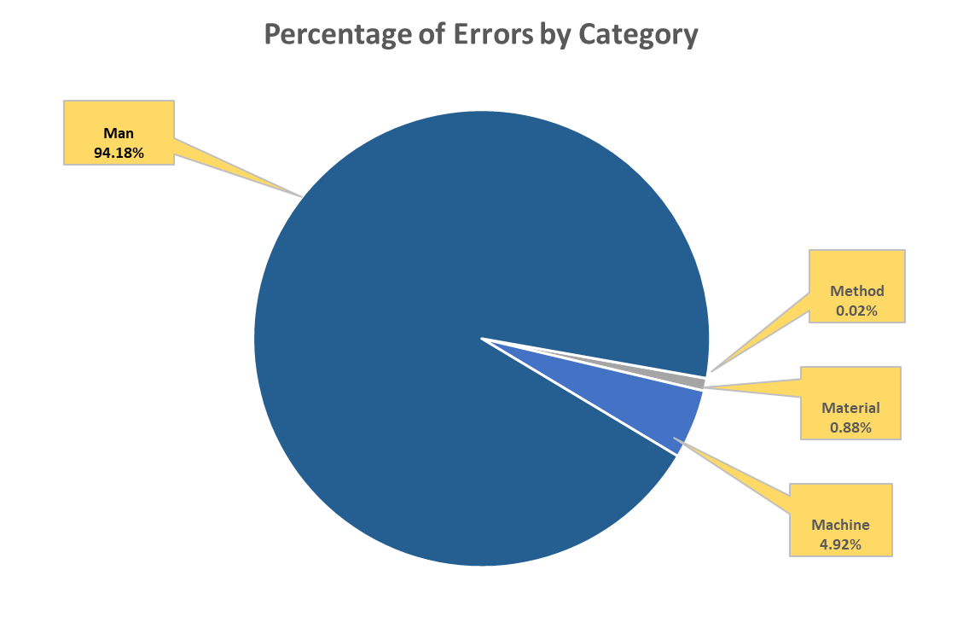
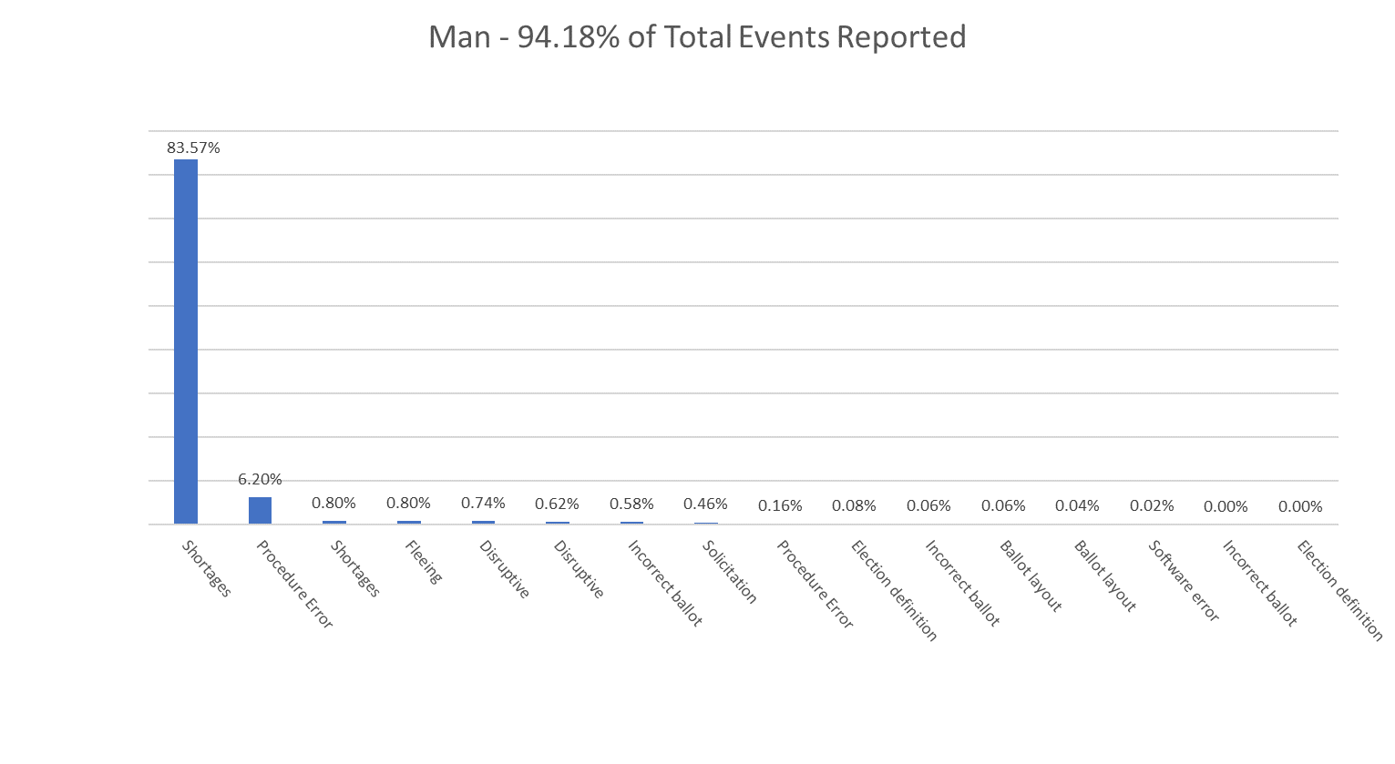
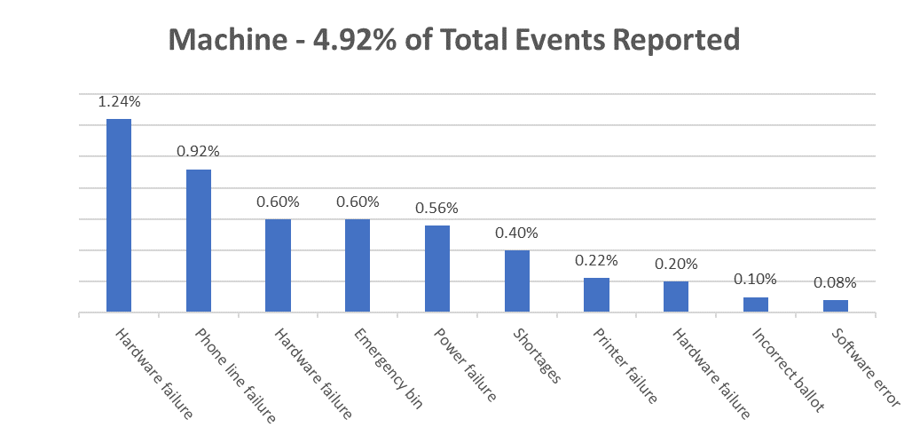
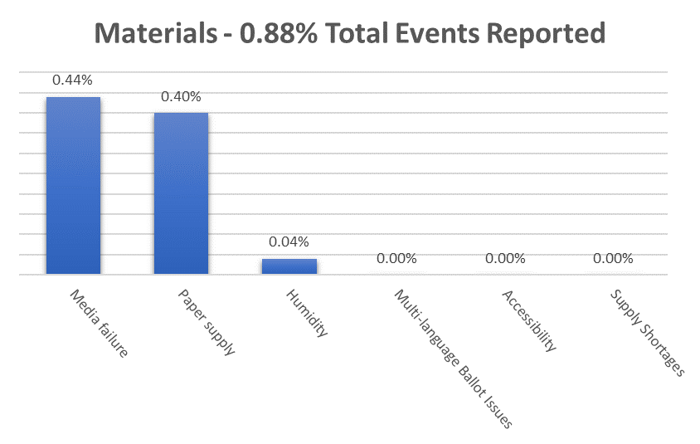
2020 Conduct of Elections Analysis

Slide 16
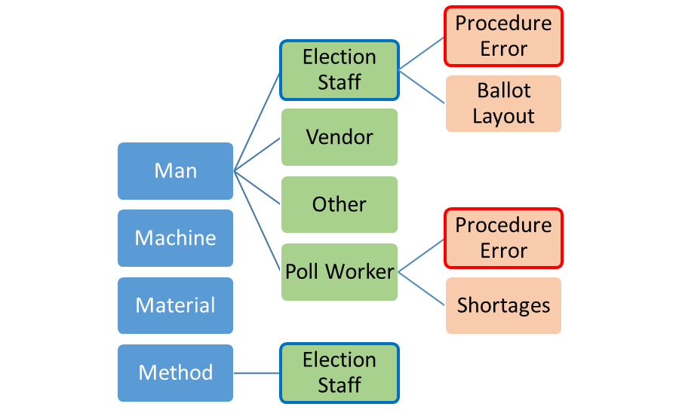
2020 Conduct of Elections Analysis
Example of Categories, Groups, and Sub-Groups

Slide 17
2020 Conduct of Elections Analysis

Slide 18
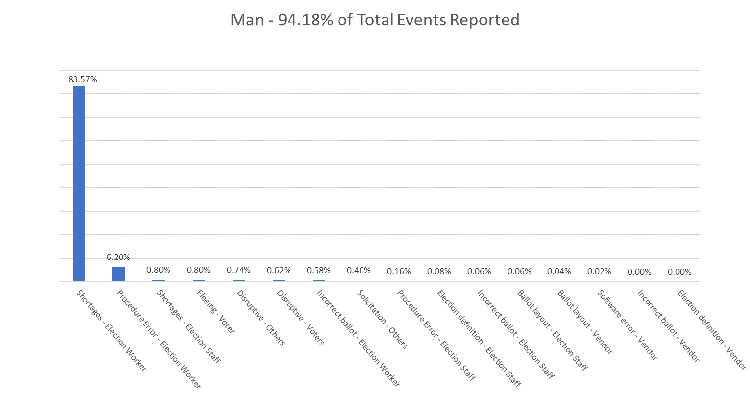
2020 Conduct of Elections Analysis

Slide 19
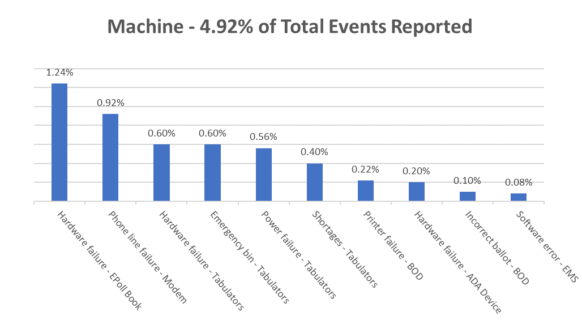
2020 Conduct of Elections Analysis

Slide 20
2020 Conduct of Elections Analysis

Slide 21
2020 Conduct of Elections Analysis
Items To Watch For
Be sure that you are using the most up-to-date version of the DS-DE 81
  The most up-to-date form may be found at https://dos.myflorida.com/elections/forms-publications/forms/
Be sure that the form has been filled out in its entirety (i.e. checkboxes and text boxes).
Be sure at least two members of the Canvassing Board sign the DS-DE 81.

Slide 22
Questions?
BVSC.reports@DOS.MyFlorida.com
Bureau of Voting Systems Certification: (850) 245-6220

Slide 23

FLORIDA
DEPARTMENT
of STATE
For more information, visit us online at:
dos.myflorida.com/elections/

